Slide 1
SAFe Training
Device Management (DM)

Slide 2
SAFe Overview

Slide 3
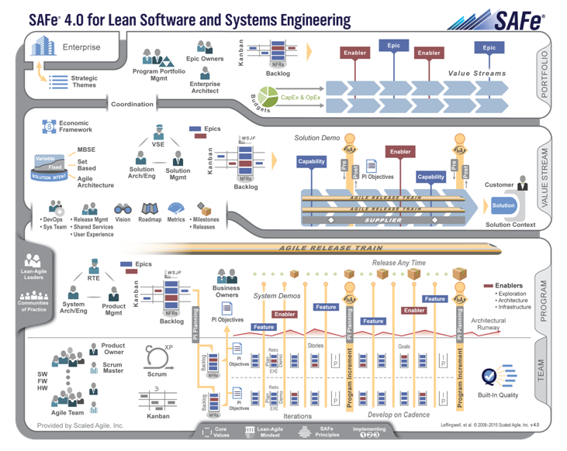
SAFe 4.0

Slide 4
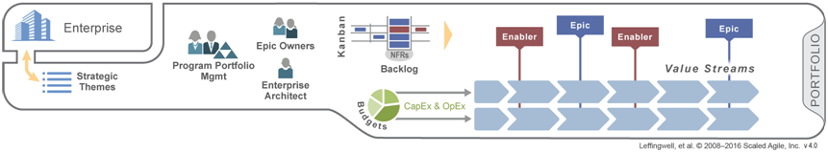
Organize the Portfolio around value
Identify and organize around Value Streams
Communicate enterprise strategy with Strategic Themes
Empower decision makers with Lean-Agile Budgeting
Provide visibility and governance to cross-cutting initiatives with Kanban

Slide 5
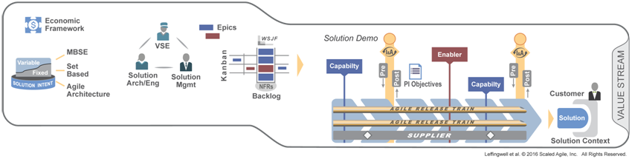
Coordinate large Value Streams
Apply cadence and synchronization
Establish governance with Value Stream roles and an Economic Framework
Manage fixed and variable Solution Intent
Manage the flow of Capabilities with the Value Stream Kanban
Frequently integrate and validate Customer Solutions

Slide 6
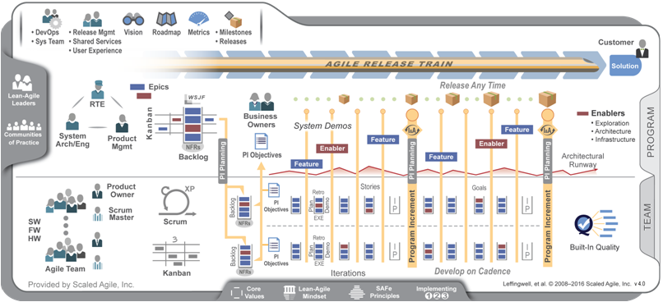
Build value with Agile Release Trains
Align to a common mission
Apply cadence and synchronization
Communicate with Vision, Roadmap, architectural guidance
Apply objective Milestones to measure progress

Slide 7
SAFe Philosophies
Philosophies
Doing Agile.
Agile
Lean
Process
Frameworks
Scrum
Kanban
Extreme Programming (XP)
Being Agile
Practices*
Continuous Integration
Automated Testing
Refactoring
TDD
Daily Stand-up
Develop on Cadence
Kanban
Planning
Team Demo
Retrospective
*Note: it’s not a full set of practices, but some typical examples used in SAFe.

Slide 8
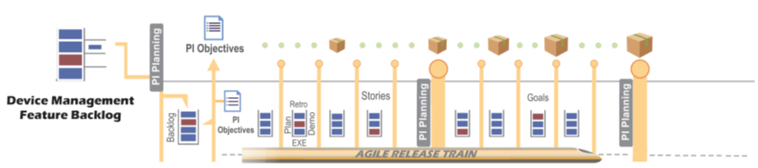
A Closer Look at DM Use of SAFe: Program Increments & Iterations
Iteration: Timebox in which teams deliver incremental value
Program Increment: A larger timebox synchronized across teams.

Slide 9
A Closer Look at DM Use of SAFe: DM Feature Backlog
DM Feature Backlog:
Product features broken down into PBIs
Iteration: Timebox in which teams deliver incremental value
Program Increment: A larger timebox synchronized across teams.

Slide 10
A Closer Look at DM Use of SAFe: PI Planning & Team PI Backlog
DM Feature Backlog:
Product features broken down into PBIs
PI Planning: 2 day event before every PI, attended by all teams, where the PI objectives are defined and planned across all teams
PI Planning: 2 day event before every PI, attended by all teams, where the PI objectives are defined and planned across all teams
Iteration: Timebox in which teams deliver incremental value
Program Increment: A larger timebox synchronized across teams.

Slide 11
A Closer Look at DM Use of SAFe: Product Releases
DM Feature Backlog:
Product features broken down into PBIs
PI Planning: 2 day event before every PI, attended by all teams, where the PI objectives are defined and planned across all teams
Product Releases:
A product can be released at any time. It does not have to be synchronized with Program Increments
PI Planning: 2 day event before every PI, attended by all teams, where the PI objectives are defined and planned across all teams
Iteration: Timebox in which teams deliver incremental value
Program Increment: A larger timebox synchronized across teams.

Slide 12

A Closer Look at DM Use of SAFe: People
DM Feature Backlog:
Product features broken down into PBIs
PI Planning: 2 day event before every PI, attended by all teams, where the PI objectives are defined and planned across all teams
Product Releases:
A product can be released at any time. It does not have to be synchronized with Program Increments
PI Planning: 2 day event before every PI, attended by all teams, where the PI objectives are defined and planned across all teams
Iteration: Timebox in which teams deliver incremental value
Program Increment: A larger timebox synchronized across teams.
Each team will have a Product Owner, Scrum Master and 1 or more Agile teams.

Slide 13
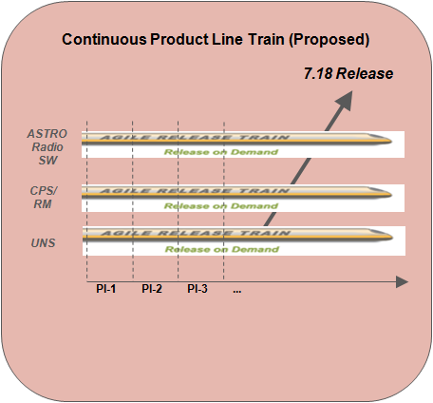
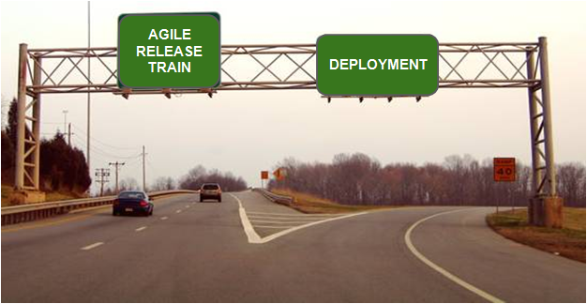
“Off Ramp” Model

Slide 14
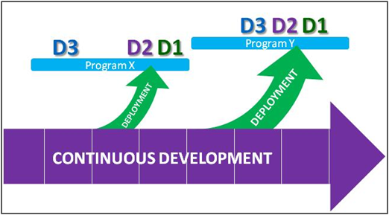
D-Stream for Continuous SAFe Trains
●D-Stream checkpoints are bound to the program, above the level of the train itself
●D3 commitment can be early or late, depending on when commitment for specific features is required
●For each D2/D1 there will be an “exit ramp” off the main train, where any post-development testing of the complete release occurs before launch (final box testing, regression testing, SIT, etc.)
●Opportunity lies in optimizing the length and capacity needs of the off ramp
●The goal of the train is to become very predictable

Slide 15
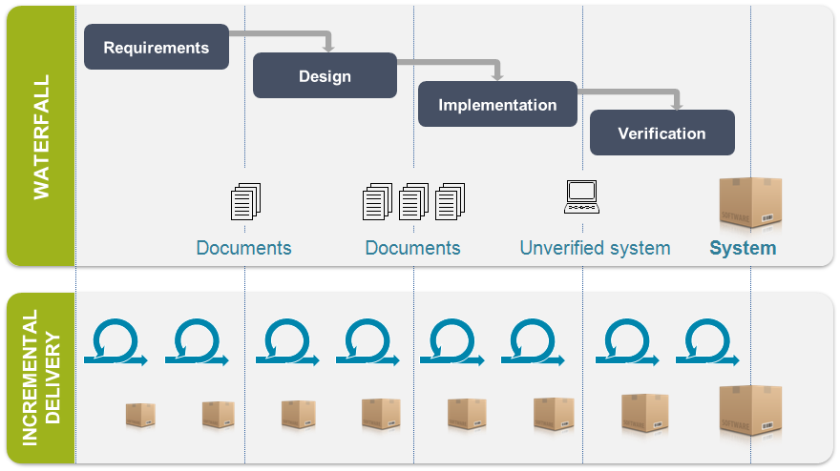
Mindset Change in SAFe
“I’m working on TETRA CPS MR15.0 pre-M5.”
“I’m working on PI16-2 for feature XXX.”

Slide 16
Device Management SAFe
Overview of Agile Release Trains and Teams used by DM

Slide 17
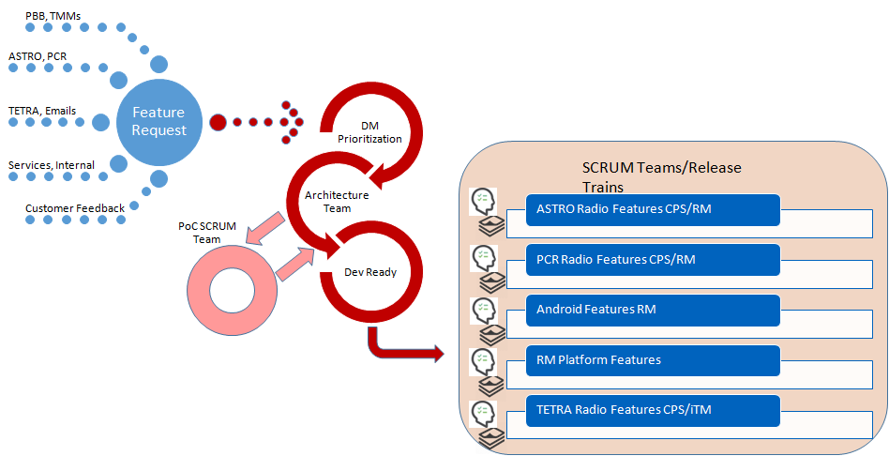
DM Feature Management Process
Reference:
DM Feature Management Process

Slide 18
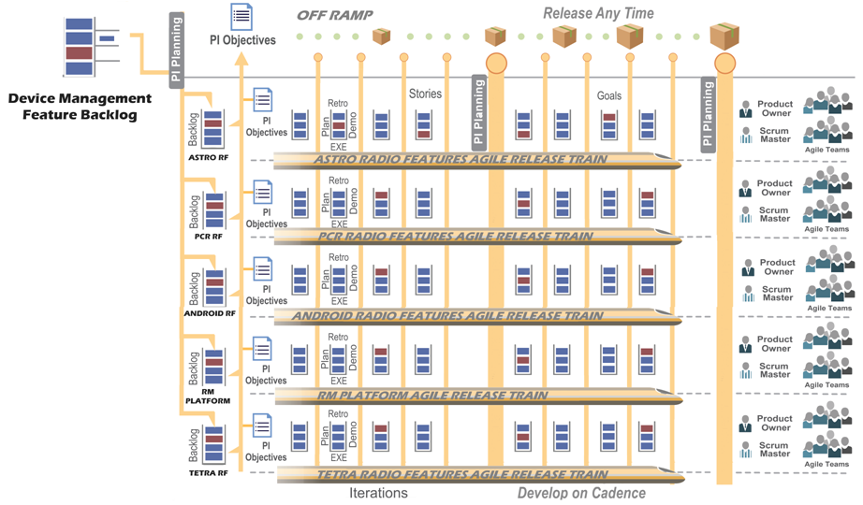
DM SAFe Trains and Teams

Slide 19
DM SAFe Trains and Teams
One ART for each Technology Radio Features and One is for RM Platform

Slide 20
DM SAFe Trains and Teams
Each ART has its own backlog

Slide 21
DM SAFe Trains and Teams
Each ART has:
Product Owner who controls the ART Backlog.
Scrum Masters and Scrum teams to implement backlog items.

Slide 22
DM SAFe Trains and Teams
Release Planning continues as today and is not synchronized with PI.
Product Owners and feature management need to prioritize and coordinate Feature and ART backlogs to make sure Release features are ready

Slide 23
DM SAFe Trains and Teams
It is key for Product Owners to coordinate cross team PBI’s during the PI Planning meetings to handle dependencies and to insure features are fully implemented in time for the release.

Slide 24
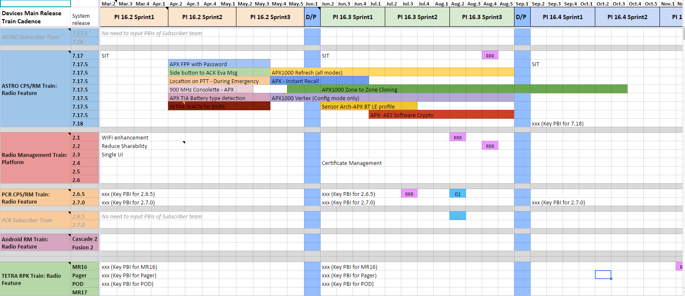
Device Management Release Train
DM Release Train:
https://docs.google.com/spreadsheets/d/1JBS5F1Hoj5rKe0wsAFo2yF72EQHieoZMt-0-7amp7nw/edit#gid=1871027125

Slide 25
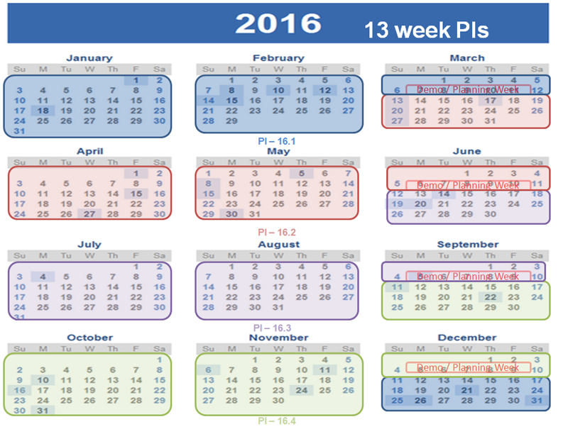
PI Plan

Slide 26
Role and Responsibility

Slide 27






Roles
Product Manager
RTE
System Arch/Eng
Product Owner
Scrum Team 2
Local PO
Scrum Team 3
Scrum Master
Resource Manager
Agile Team
Scrum Team 1

Slide 28
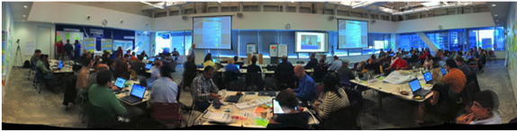
Role and Responsibility - PI Planning
- Attend PI Planning Meeting.
- Understand product vision and roadmaps.
- Understand PI objectives and releases content.
- Encourage high-bandwidth communication across all team members and stakeholders.
- Encourage team member to build up the social network the ART depends upon.
- Facilitate team's activities in PI Planning Meeting.
- Attend PI Planning Meeting. Understand the PI, the schedule and resources.
- Assistant Local PO and PO\RTE to finish ART alignment work on resource issue.
- Warmly involved in Team Breakouts session to assess team estimation and capacity.
> Attend PI Planning Meeting.
> Work with Product Manager to make contributions to vision and program backlog.
> ART alignment role between CPS Technology CPS/RM ART and Subscriber ART.
> ART alignment role between Technology CPS/RM ART and RM Platform ART.
Product Owner
Resource Manager
Scrum Master
RTE
- Attend PI Planning Meeting.
- Owns vision and roadmaps, program backlog, pricing, licensing, ROI.
- Share product vision and roadmaps to team.
- Attend PI Planning Meeting.
- Understand product vision and roadmaps.
- Understand PI objectives and releases content.
- Attend PI Planning Meeting.
- Understand product vision and roadmaps.
- Understand PI objectives and releases content.
- Active perform in Team Breakouts session.
Product Manager
Agile Team
Local PO
Detail refer to R&R

Slide 29
Role and Responsibility - Preparation for Product Backlog Refinement
- Work with Product Manager to refine feature and enabler. - Own Product Backlogs, breakdown feature and enabler to PBIs. - Make sure every PBI and AC follow the syntax defined by team. - Make sure every PBI follow DEEP (Detailed Appropriately, Estimated, Emergent, Prioritized) - Work with Product Manager to establish feature acceptance criteria.
- Know priority for features and enablers.
- Coordinate the work of product backlog grooming between Development Team and PO.
- Understand the breakdown from feature or enabler to PBIs. - Fix Resource issues
Product Owner
Resource Manager
Scrum Master
RTE
Product Backlog Refinement
- Establishes feature acceptance criteria
- Know priority for features and enablers - Support PO to finish PBIs and ACs - Review PBIs and ACs within Scrum Team
- Know priority for features and enablers - Review and verify PBIs are READY for implementation.
Product Manager
Agile Team
Local PO
Detail refer to R&R

Slide 30
Role and Responsibility - Sprint Planning
- Make sure Sprint Planning (goals and schedule) align with PI Planning (objectives and schedule).
- Know historical velocity - Make sure timebox the planning meeting to 4 hours or less - Make sure the planning meeting is held by and for the team - Make sure team should not commit to work in excess of its adjusted capacity or historical velocity. - Ensure team use relative estimation method.
- Review Sprint Plan for goals, scope and schedule - Make sure team use relative estimations
Product Owner
Resource Manager
Scrum Master
RTE
Sprint Planning
- Know historical velocity - Understand the preliminary Sprint goals. - Understand the higher-priority user stories according to selected PBIs. - Sizes/resizes each story and splits them if necessary. - Elaborates acceptance criteria through conversation - In ranked order, breaks stories into tasks, if necessary. - Define iterations and stories. - Commits to the final Sprint goals - Must use relative estimation method.
- Prepare preliminary Sprint goals based on team progress in the PI objectives. - Present the preliminary Sprint goals. - Present selected higher-priority PBIs in user stories. - Owns team backlog and implementation - Based on size and value/time/risk, re-rank stories if necessary
Product Manager
Agile Team
Local PO
Detail refer to R&R

Slide 31
Role and Responsibility - Sprint Execution
- Agile Coach - Servant Leader - Process Authority - Interference Shield - Impediment Remover - Change Agent - Talk to other ScrumMaster - Scrum of Scrum for ART
- Know sprint delivery progress, sprint metrics - Check status on self-managed development team for opportunity
- Question answer on PBI
Product Owner
Resource Manager
Scrum Master
RTE
Sprint Execution
- Setup Agile team rule before sprint/iteration start. - Tracking Sprint Progress through agreed-to sprint metrics - Implement stories incrementally - Constant communication and synchronization via daily Stand-Up meetings. - Optimize flow by managing WIP, building quality in, and continuously accepting stories. - Work together as an ART to achieve program PI objectives. - Make sure every task, SBI meet DoD.
- Question answer on PBI - Check Sprint delivery progress
Product Manager
Agile Team
Local PO
Detail refer to R&R

Slide 32
Role and Responsibility - Daily Stand-Up
- Keep silent if possible as an observer. Not the focus or speaker in Daily Stand-Up. - Find individuals to follow up if there's any problem that not compliant with agile principles.
- Sampling attendance to find opportunity
Product Owner
Resource Manager
Scrum Master
RTE
Daily Stand-Up
- Answer the three questions: . What did I get DONE yesterday? . What will I get DONE today? . Any impediments blocking me ?
- Standby for question answer on PBI
Product Manager
Agile Team
Local PO
Detail refer to R&R

Slide 33
Role and Responsibility - Sprint Review
- Attend Sprint Review meeting and provide feedback - Say "Yes" or "No" to Sprint Goals achieved or not according to Demo result - Assess delivery progress to PI Objectives.
- Help team and PO to hold the demo meeting. - Keep the meeting timeboxed to an hour or less. - Make sure share demo responsibilities among development team members and PO who have new features to demonstrate. - Make sure only demonstrate working and tested features. Don't waste time on fail case. Log it for further action!
- Optional to attend this review
Product Owner
Resource Manager
Scrum Master
RTE
Sprint Review
- Optional to attend this review
- Responsible for running the product/feature demo - Q&A - Wrap up by summarizing progress, feedback, and action items.
- Q&A - Identify risks and impediments
Product Manager
Agile Team
Local PO
Detail refer to R&R

Slide 34
Role and Responsibility - Sprint Retrospective
- Prepare well before the meeting, as it is a primary vehicle for improvement. - Keep the meeting timeboxed to an hour or less. - Make sure only pick one or two things that can be done better for next Sprint for improvement. - Make sure everyone speak - Make sure team focus on items the team can control and improve, not on how others can improve. - Make sure improvement stories from the previous sprint are reviewed and the beginning. - This is private meeting, make sure limited only to development team members. - Talk to PO if necessary.
- Change Owner. Work with ScrumMaster to identify and implement process and tools changes with resource providing or leveraging.
Product Owner
Scrum Master
Resource Manager
RTE
Sprint Retrospective
- Review agreed-to sprint metrics - Review the improvement stories from previous Sprints, Were they all accomplished ? If not, what are the further actions. - For this sprint, analyze . What shall we start doing? . What shall we stop doing? . What shall we keep doing?
- Review Improvement stories as the results of the meeting.
Product Manager
Agile Team
Local PO
Detail refer to R&R

Slide 35
Role and Responsibility - PI Review
- Demo all the PI Objectives implemented in current PI. - Work with Product Manager to find opportunity. - Wrap all the opportunities with priority and work with team to put them into PBI stack.
Product Owner
Scrum Master
Resource Manager
RTE
PI Review
- Review Demo. - Checking whether all the PI Objectives are met or not. If there is any PI Objective not meet, discuss with PO (facing biz) for follow-ups. - Assess the impact to value stream and ART.
- Help PO/RTE to prepare the demo to Product Manager and other stakeholders.
Product Manager
Agile Team
Local PO
Detail refer to R&R

Slide 36
Reference
Scaled Agile Framework (SAFe) Web Page
DM Feature Management Process
DM Release Train
Detailed DM SAFe Role and Responsibility

Slide 37
Thank You!

